Slide 1
Bioequivalence study of two low molecular weight heparin in healthy volunteers

Slide 2
Focus of the study
Department of Clinical Pharmacology
First Affiliated Hospital of College of Medicine,
Zheijang University
79 Qingchun Road, Hangzhou, Zheijang,
People’s Republic of China

Slide 3
Aim
The aim of the present study is to determine if Clexane and Olxarin (Enoxaparin manufactured by Hangzhou Jiuyuan Gene Engineering Co., Ltd) can be regarded as bioequivalent at the dose level administered in healthy subjects.

Slide 4
Design of the study
The study protocol was approved by the Ethics Committee of First Affiliated Hospital of College of Medicine, Zheijang University, China.
Reference (60mg. Batch no. 7440, Clexane) from Aventis Pharma
Test (60mg. Batch no. 20060902, Olxarin) from Hangzhou Jiuyuan Gene Engineering Co., Ltd.
Given in a randomized, cross over design to 22 healthy subject with a minimum 7-day washout period.

Slide 5
Healthy Subjects
22 healthy male subjects between age 19 to 23 years with a mean body weight 64.06+5.92kg. (range 54 to 75kg) entered the study after giving informed consent.
The study group was divided as Group-1 (G1) and Group-2 (G2).

Slide 6
Laboratory Analysis
To determine if reference and test enoxaparin can be regarded as bioequivalent, the following biological markers studied were:
Anti-Xa activities
Anti-Ha activities
Activated partial thromboplastin time (APTT)
Heptest plasma activities

Slide 7
Results
The peak anti-Xa was:
  0.883+0.098 IU/ml with test
  0.855+0.199 IU/ml with reference product.
In conclusion, the test formulation of LMWH injection is bioequivalent with reference LMWH injection.

Slide 8
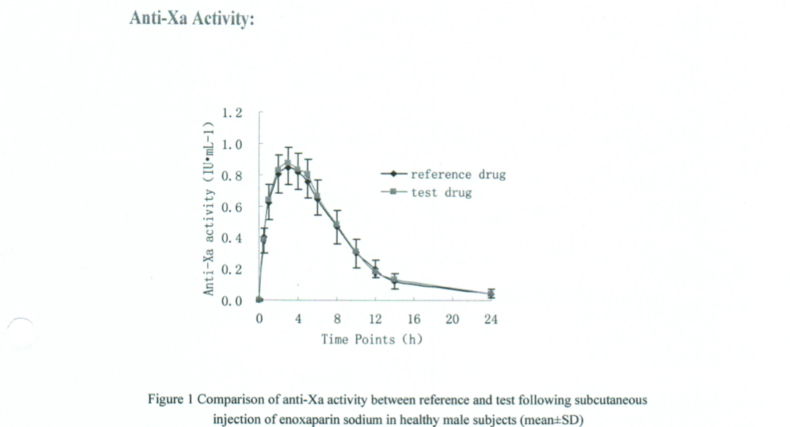
Result

Slide 9
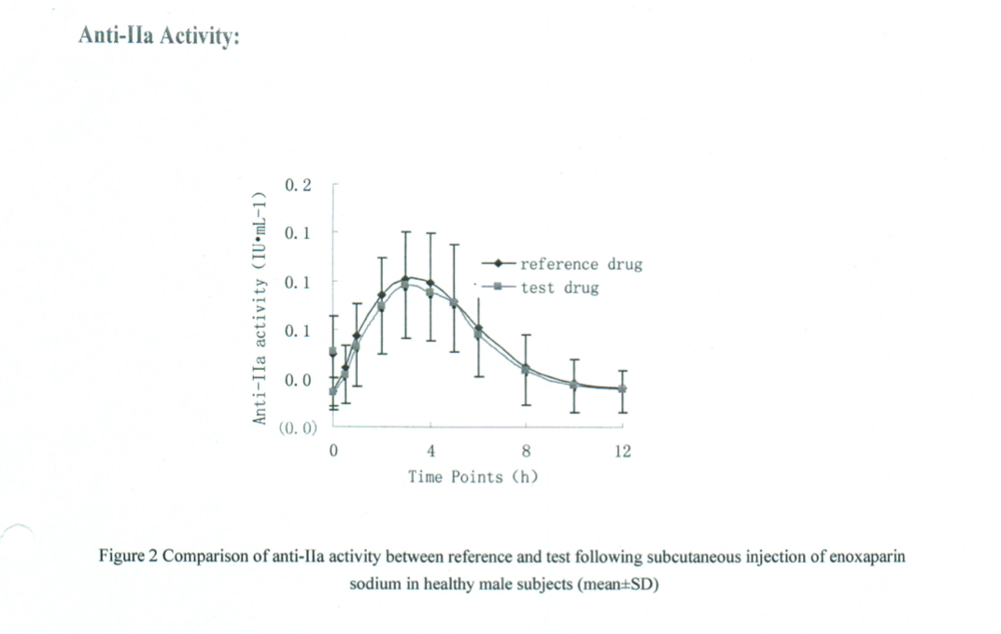
Result

Slide 10
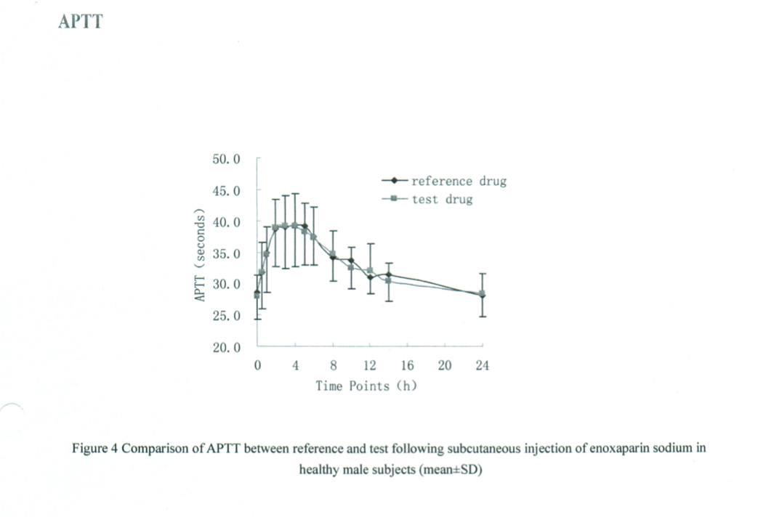
Result

Slide 11
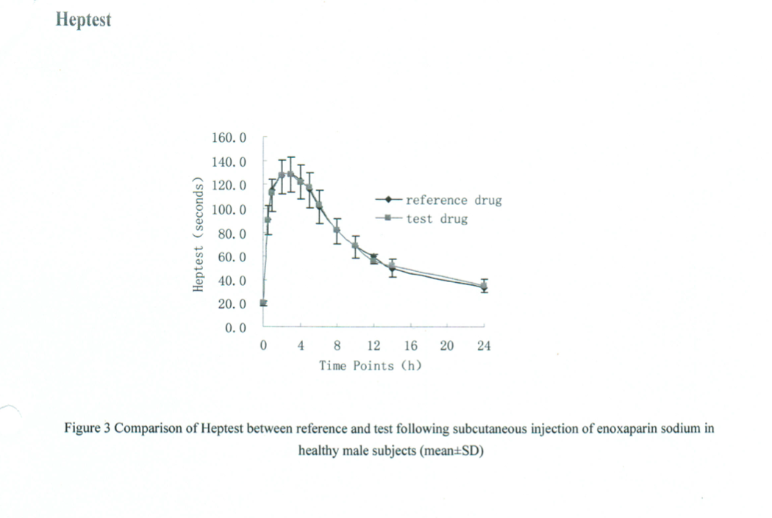
Result

Slide 12
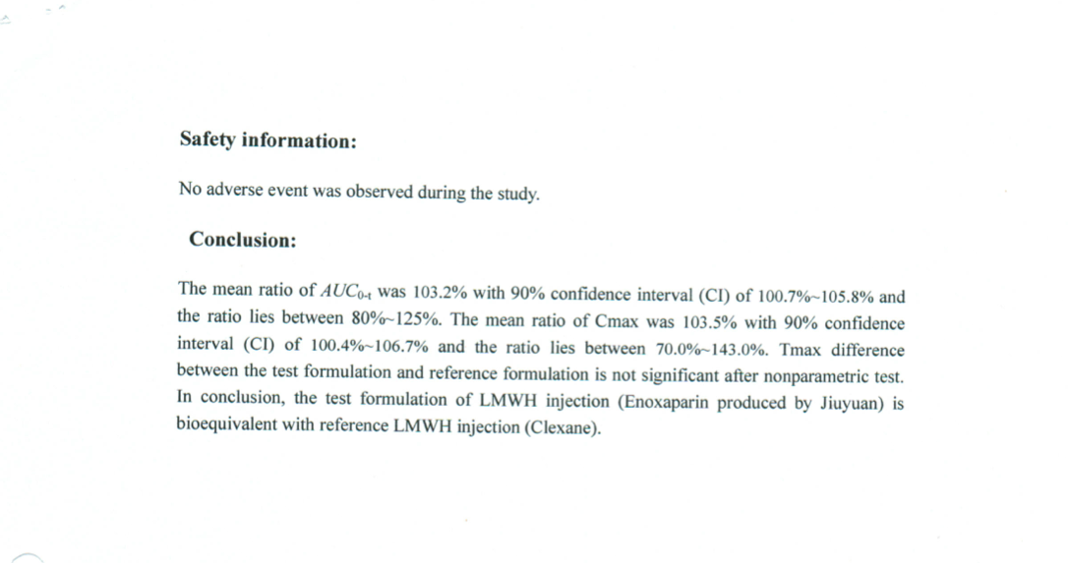

Slide 13
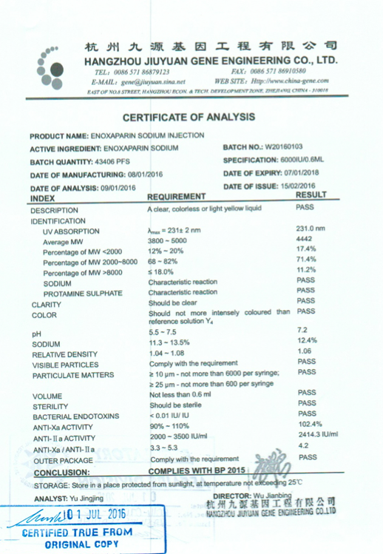
Other Documents

Slide 14
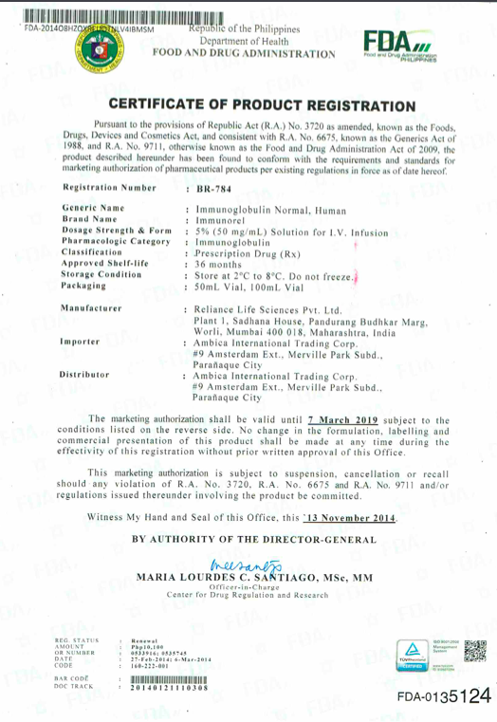
Other Documents

Slide 15
Attention
All Documents and Bioequivalence study are available upon request…

Slide 16
APAS
Antiphospholipid syndrome (APAS) is an immune disorder in which abnormal antibodies are linked to abnormal blood clots in veins and arteries. It mostly affects the legs, but clots may also form in kidney, lungs, and other organs. APAS is also known as sticky blood. Promote OLXARIN to these doctors handling "High Risk Pregnancies".

Slide 17








